Slide 1




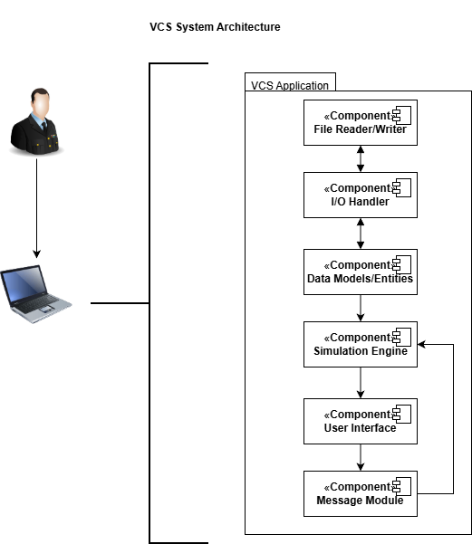
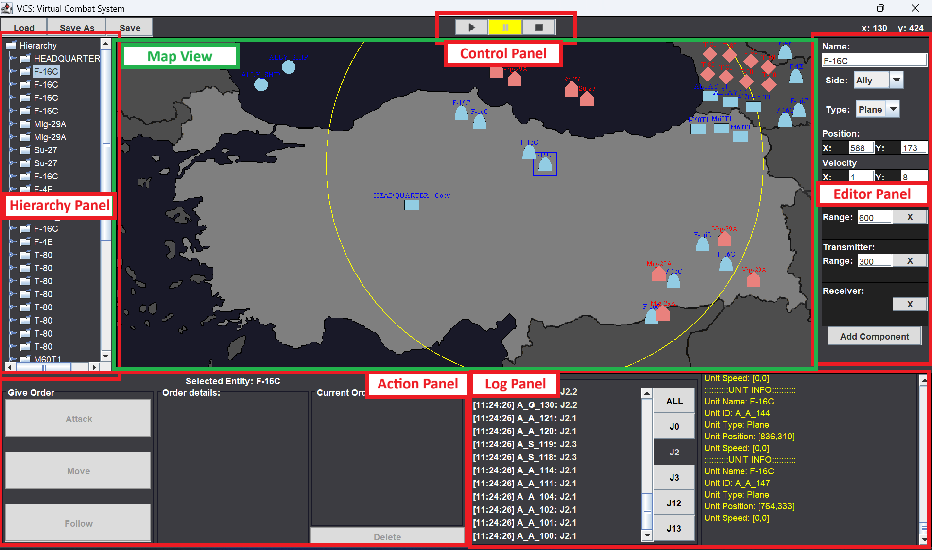

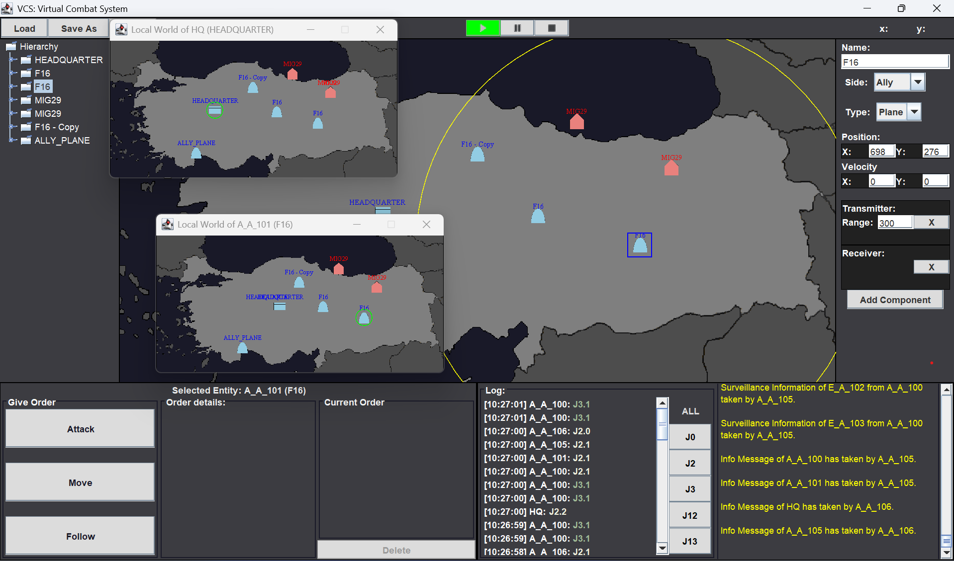









VIRTUAL COMBAT SYSTEM
Supervised by
Prof. Dr. Gökhan ŞENGÜL, Prof. Dr. Sacip TOKER
CMPE494 & ISE494 Senior Project
2025-2026 Fall
Team
Design and Architecture
Interfaces
Seda KOCAOĞLU CMPE
Mert KAVİLCİOĞLU ISE
o
Objective
The aim of VCS is to provide a simulation environment to the military command & control units for simulating various combat scenarios on the Türkiye map for the purpose of observing possible Tactical Data Link communications between the air, ground and naval units and to take precatuions for communication problems that may be occured during the real exercises or real combat.
Methods/Tools
Application Areas
Used Methodologies:
For the project management, the waterfall method is used properly.
As a programming approach, "Entity Component System" is used for the development of simulation engine.
Used Tools:
GitHub Desktop: Used for version control of the software.
Java: Used JDK 22 for the development of simulation engine.
Swing: Used Swing library of Java for the development of interfaces.
IntelliJ IDEA: Used as Java programming IDE.
VCS is developed for military purposes and assumed to be used by military operators. The results and precautions taken by the help of VCS are conjectured to decrease real exercise costs and risks, and also increase the situational awareness during the real combat with the contribution of simulation results.
Conclusion
GitHub Repository
References
VCS proved that simulating the military operations virtually is possible and have many advantages especially in cost and time for observing the TDL communication.

